Slide 1



X
Business Performance Analytics 2020 - 2023
Kimia Farma - Big Data Analytics
Presented by
Handi Widiansyah

Slide 2

Disclaimer
Anda dapat mengganti design template ini sesuai kreativitas kalian. Anda dapat menambahkan slide sesuai kebutuhan.
Template ini hanya bertujuan untuk memberikan gambaran isi konten yang wajib dibuat oleh peserta. SIlahkan hapus slide ini setelah anda membuat salinan dokumen ini di drive Anda

Slide 3





Handi Widiansyah
Data Enthusiast
Fresh graduate from Metallurgical Engineering, University of Indonesia, with interests in the fields of Data Analyst, Data Scientist, and Business Intelligence. Experienced in Data Analyst positions in manufacturing production. Have expertise in the use of SQL, Python and Data Visualization languages. Continue to increase experience and knowledge in the world of Data Science through bootcamps, courses, competitions and projects. With a relentless commitment to learning and innovation, I am ready to make significant contributions to drive the success of data-driven companies.
Jakarta, Indonesia
handiwidiansyah@gmail.com
Handi Widiansyah | LinkedIn

Slide 4
Courses and Certification
SQL: A Practical Introduction for Querying Databases | <link certificate> <Mar, 2024> SQL for Data Analysis | <link certificate> <Feb, 2024> Intro to Data Analytics | <link certificate> <Dec, 2023> Intro to Programming | <link certificate> <Feb, 2024> Analyzing and Visualizing Data With Power BI | <link certificate> <Mar, 2024>

Slide 5

About Company
Kimia Farma was the first pharmaceutical industrial company in Indonesia which was founded by the Dutch East Indies Government in 1817. The name of this company was originally NV Chemicalien Handle Rathkamp & Co. Based on the nationalization policy of former Dutch companies in the early days of independence, in 1958, the Government of the Republic of Indonesia merged a number of pharmaceutical companies into PNF (Pharmaceutical State Company) Bhinneka Kimia Farma. Then on August 16 1971, the legal entity form of PNF was changed to a Limited Liability Company, so the company name changed to PT Kimia Farma (Persero).

Slide 6
Project Portfolio
As a Big Data Analytics Intern at Kimia Farma, I am faced with a series of challenges that require a deep understanding of data and analytical skills. One of my main projects is evaluating Kimia Farma's business performance from 2020 to 2023. With the existing dataset, namely:
- kf_final_transaction
- kf_inventory
- kf_branch_office
- kf_product
I created a new analysis table which is a datamart using the Google Cloud BigQuery platform. From the analysis table that was created using SQL, I created a report in the form of data visualization using Looker Studio. The report is then presented via video presentation.
Project repository here!
https://github.com/handiwidiansyah/Project-based-Internship-Kimia-Farma-Big-Data-Analytics.git
Project explanation video here!
https://youtu.be/8KatwB24GFs

Slide 7
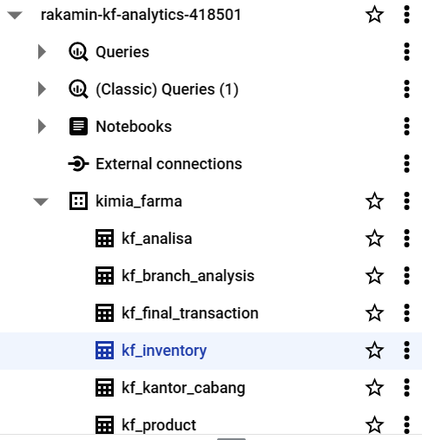
Importing Dataset to BigQuery
The first thing I did was import the table. The table provided includes:
Kf_final_transaction
Kf_inventory
Kf_branch_office
kf_product
In BigQuery, the first thing I did was create a new project called "Rakamin_KF_Analytics". After creating the project, I created a new dataset with the name "kimia_farma" inside the project "Rakamin_KF_Analytics". Finally, I imported the given table into the "kimia_farma" dataset.

Slide 8
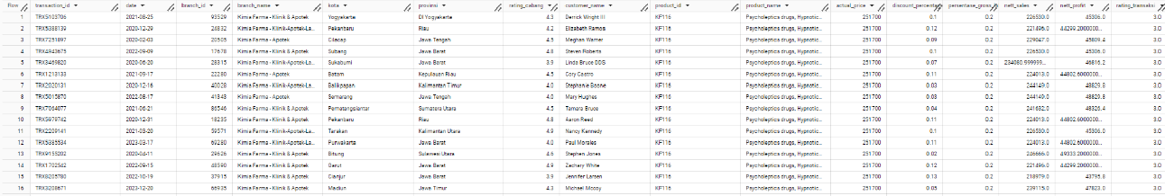
Tabel Analisa
Next, I created an analysis table using a query in BigQuery. There are several columns that must be present in the analysis table. The analysis table is then named "kf_analisa" which can be seen in the preview in the following image.

Slide 9
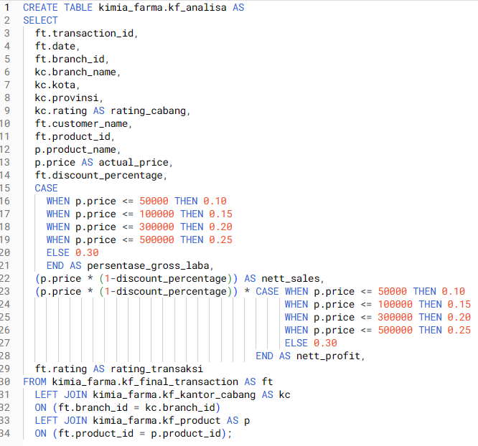
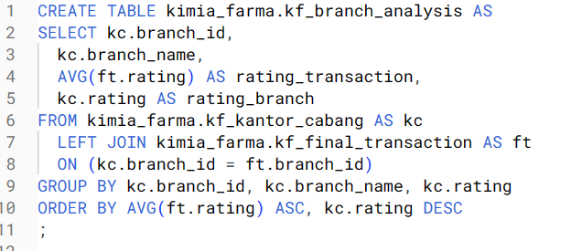
BigQuery Syntax
I created a syntax to create an analysis table with the required columns using the "CREATE TABLE" , “JOIN” function and there is also "CASE WHEN". To make visualization easier, I created an additional table called "kf_branch_analysis".

Slide 10
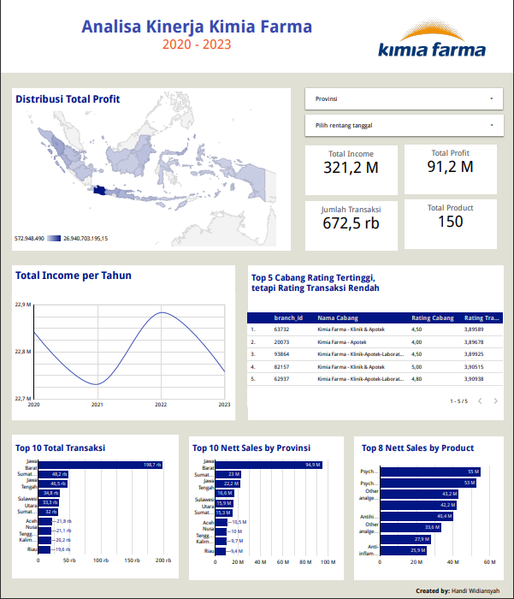
Dashboard Performance Analytics
Then, from the analysis table that was created with a query, I visualized the data using Looker Studio.
Project Dashboard here!
https://lookerstudio.google.com/reporting/eeffe0ce-e4e6-4304-9eb0-4fb5aba63761

Slide 11
Thank You
X

